Slide 1
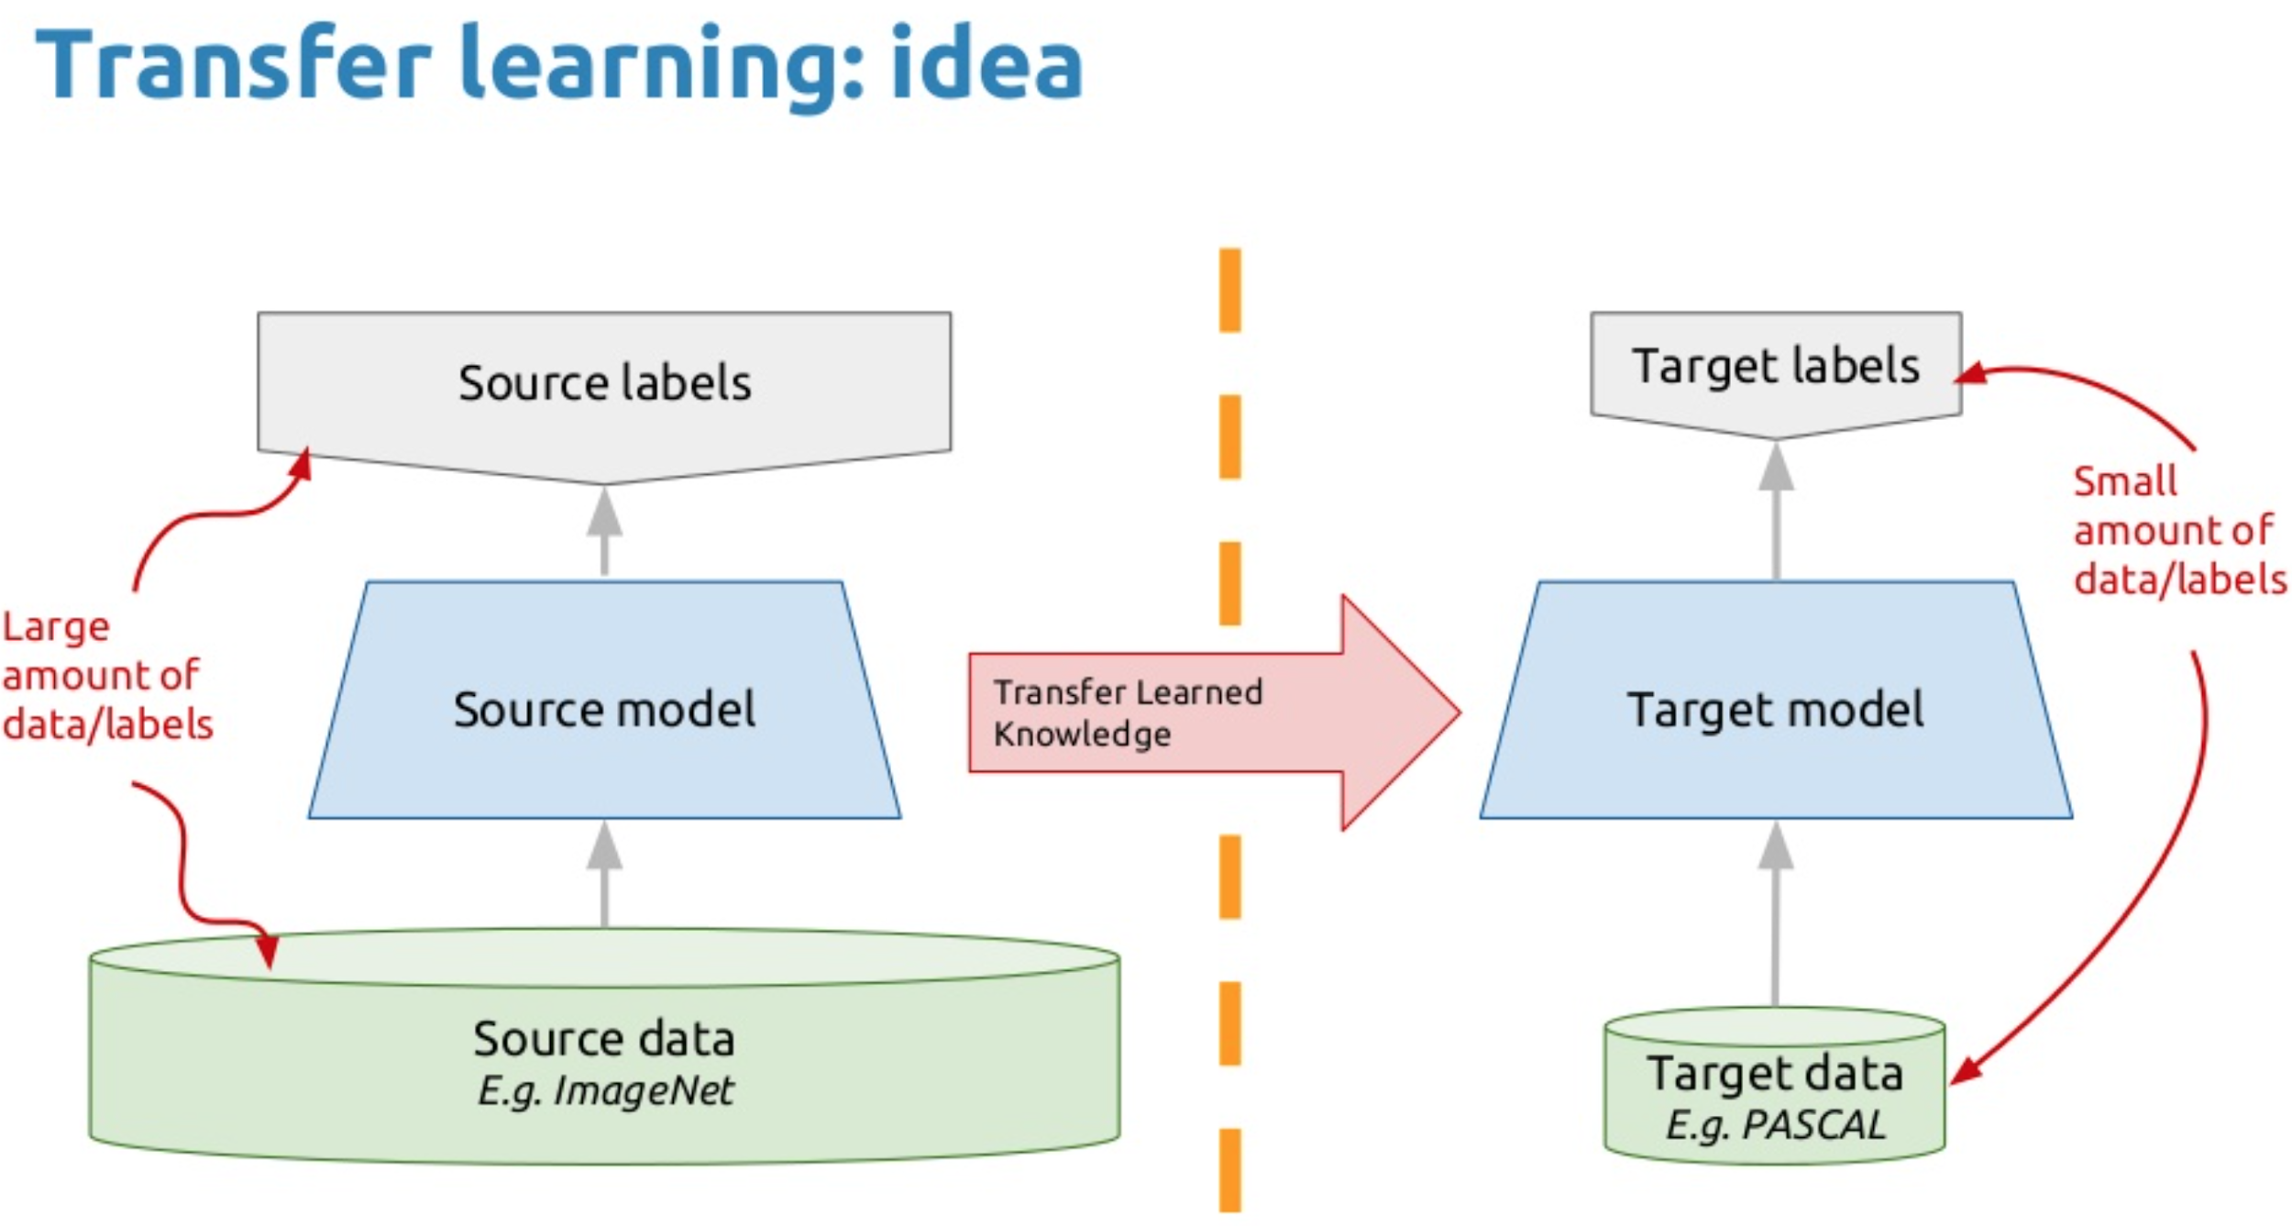
Methods to improve the classification accuracy
Method 1:
Transfer learning of classification network based on synthetic dataset.
Based on accuracy Inceptionv3 is chosen as the model for this task.
Pro’s:
Easy to train and takes fewer hours to train.
Con’s :
May not work if dataset for pretrained network has a different distribution than the dataset used for fine-tuning the network.

Slide 2
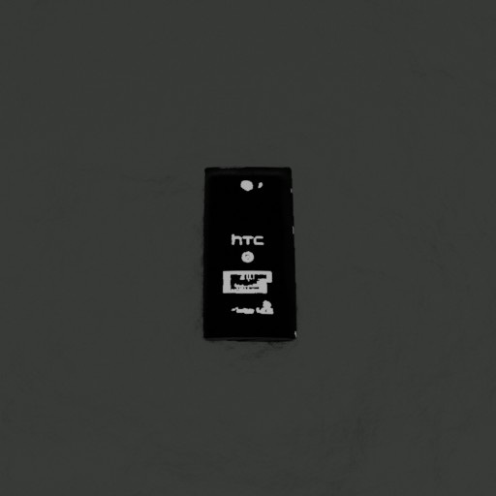
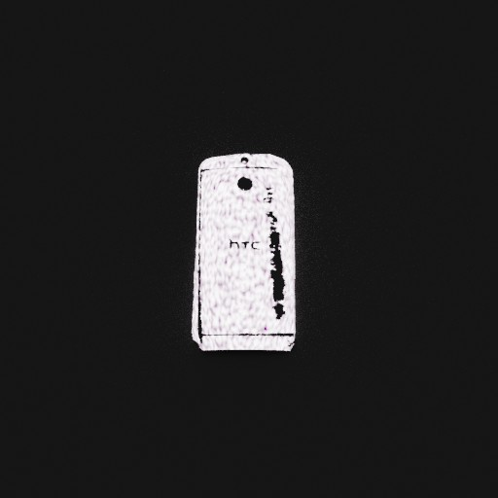

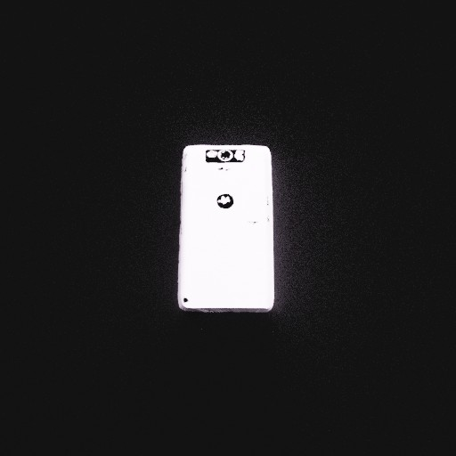
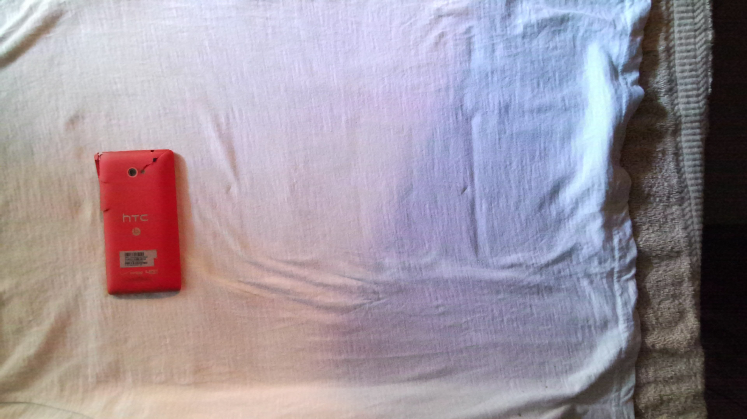
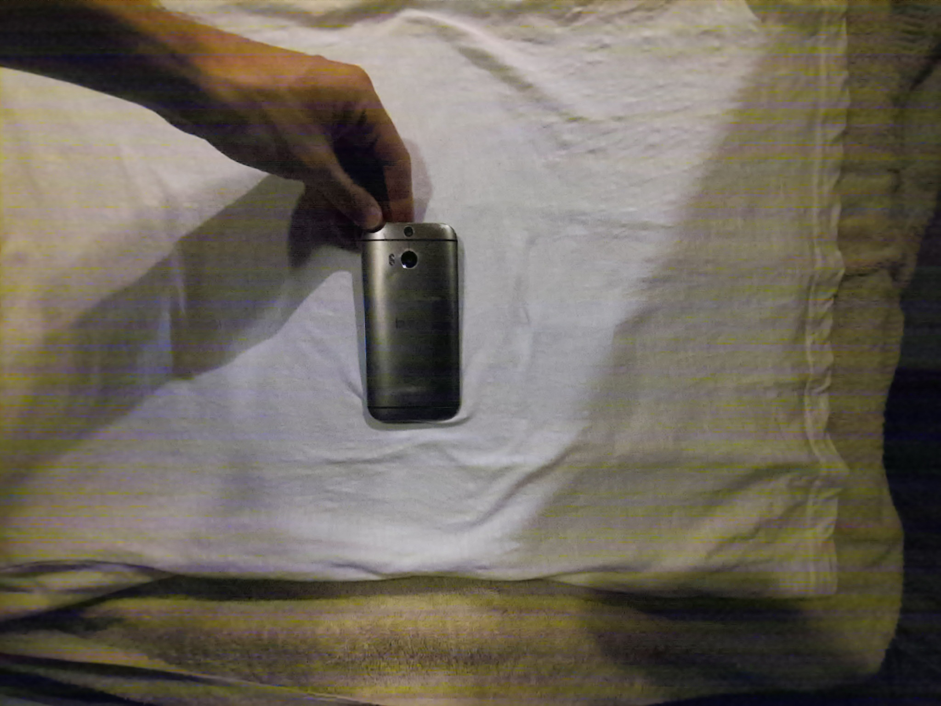
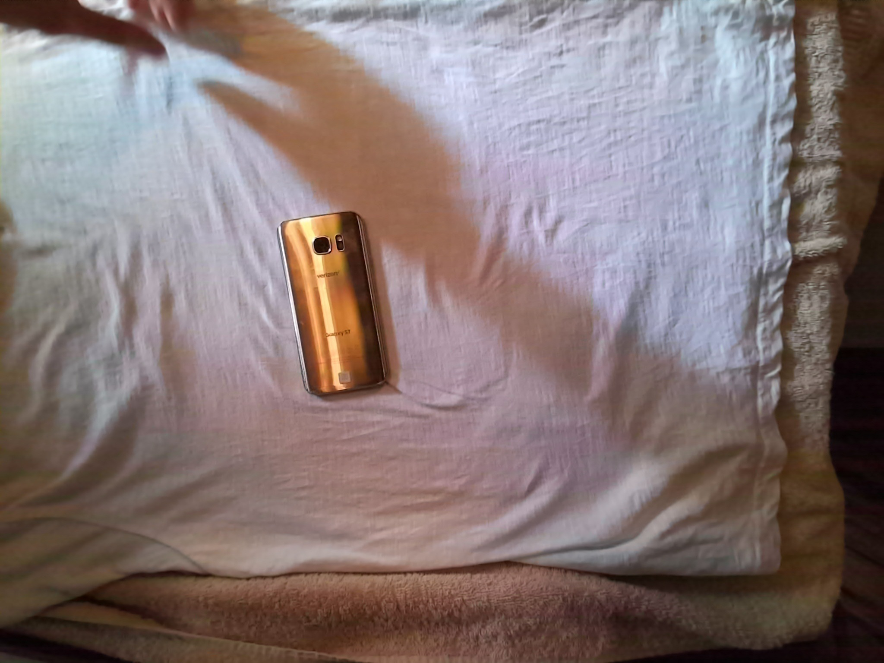
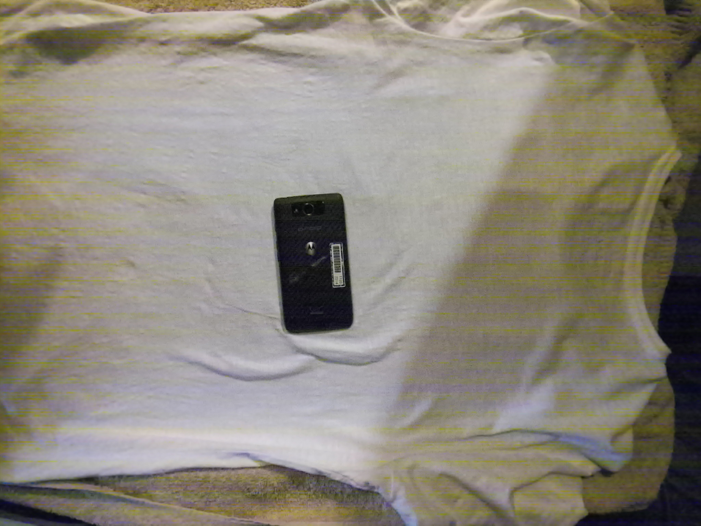
Method 2:
Transfer learning of classification network based on synthetic+real phone dataset.
Based on accuracy Inceptionv3 is chosen as the model for this task.
Pro’s:
Combination of synthetic and real dataset covers a large distribution of dataset and thus makes the model more robust.
Con’s :
Only has single view of each of the synthetic as well as real phones in the dataset.

Slide 3
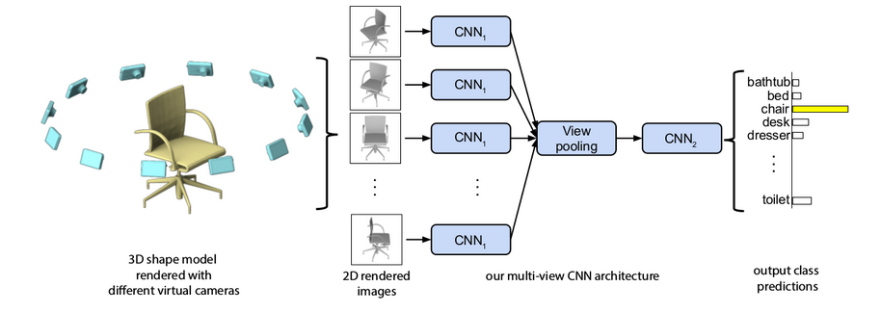
Method3
Classification model trained on multiple views of the same object.
Dataset includes both synthetic phones as well as real phones.

Slide 4




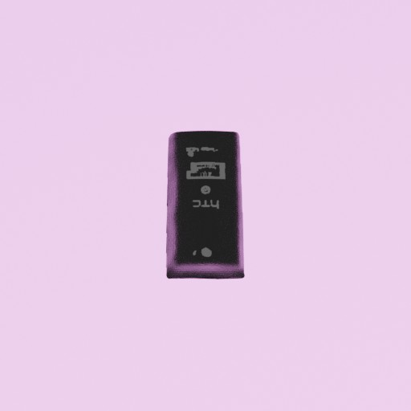


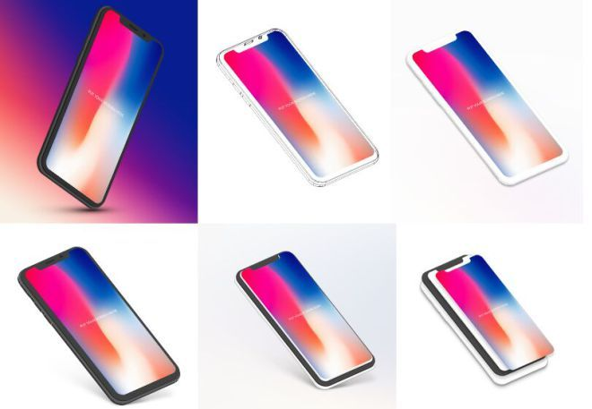
Generation of multi-view dataset for Method3:
Synthetic Dataset
Real dataset
Conditional Cycle GAN

Slide 5
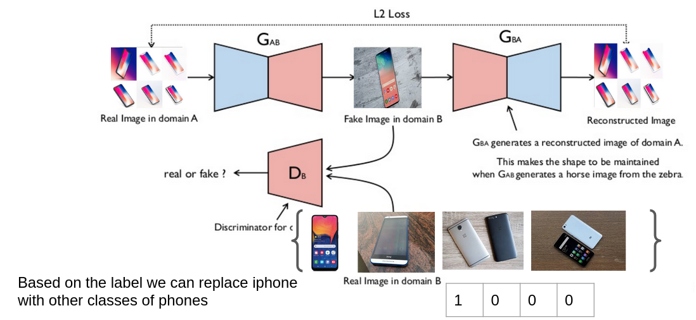
Proposed network architecture for conditional cycle gan

